Slide 1
Welcome to IEEE 802
Newcomer Orientation
www.ieee802.org

Slide 2
Contents
Introduction to IEEE 802
Introduction to IEEE standards process
Getting more information

Slide 3
Introduction to IEEE 802

Slide 4
Who we are
OSI Reference
Model
IEEE Project 802 LAN/MAN Standards Committee (aka IEEE 802 or LMSC)
  Develop LAN and MAN standards
  Mainly for link and physical layers of the network stack
  In operation since March 1980
Application
Presentation
Session
Transport
Network
Data Link
IEEE
802
Physcial
Medium

Slide 5
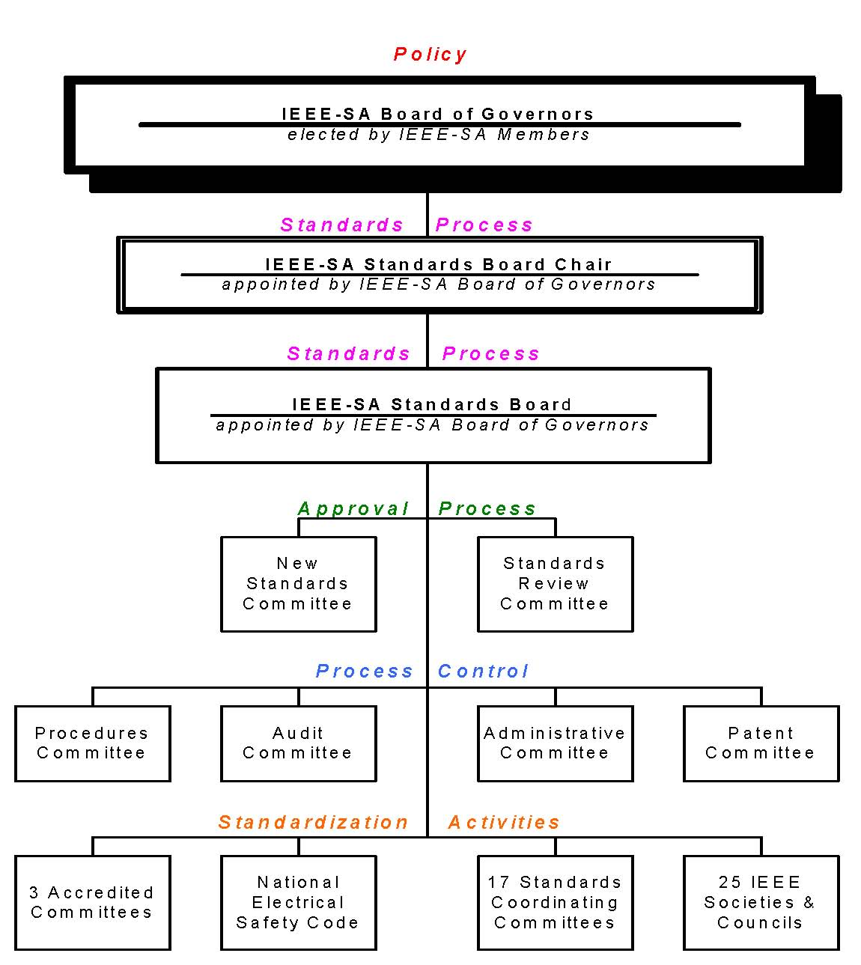
IEEE Standards
Organization
aka NesCom
aka RevCom
IEEE 802 is here:
a standards committee
formed by the
Computer Society

Slide 6
Some terms
PAR – project authorization request – the document that authorizes work on a project.
WG - Working group – responsible for developing standards in an area
TAG – Technical Advisory Group – experts on a topic area that crosses working groups – may develop a recommended practice.
Task group or task force – a part of a working group which focuses on a particular project.

Slide 7
All those dots….decoder ring
802.1 Bridging and Architecture – generally the top of the link layer
802.3 CSMA/CD – Carrier sense multiple access/collision detect – wired Ethernet
802.11 WLAN – wireless LAN
802.15 WPAN – wireless personal area network
802.16 BWA – broadband wireless access
802.17 ResPackRing – resilient packet ring
802.18 Radio Regulatory TAG
802.19 Coexistance TAG
802.20 MBWA – mobile broadband wireless access
802.21 Media Independent Handoff
802.22 WRAN - wireless regional area networks

Slide 8
IEEE 802 Organization
EXECUTIVE COMMITTEE (EC)
CHAIR
Paul Nikolich
WORKING GROUP/TAG CHAIRS
APPOINTED OFFICERS
802.1
BRIDGING/ARCH
Tony Jeffree
802.3
CSMA/CD
David Law
802.11
WLAN
Bruce Kraemer
802.18 TAG
Radio Regulatory
Mike Lynch
1st VICE CHAIR
Mat Sherman
2nd VICE CHAIR
Pat Thaler
802.15
WPAN
Bob Heile
802.16
BWA
Roger Marks
802.17
ResPackRing
John Lemon
802.19 TAG
Coexistance
Steve Shellhammer
EXECUTIVE SECY
Buzz Rigsbee
RECORDING SECY
James Gilb
802.20
MBWA
Mark Klerer
802.21
Handoff
Vivek Gupta
802.22
WRAN
Carl Stevenson
TREASURER
John
Hawkins
MEMBER
EMERITUS
Geoff
Thompson
HIBERNATION
802.2 LLC (Dave Carlson)
802.5 Token Ring (Bob Love)
DISBANDED
802.4 Token Bus 802.6 DQDB
802.7 Broadband TAG 802.8 Fiber Optic TAG
802.9 ISLAN 802.10 Security
802.12 Demand Priority 802.14 CATV

Slide 9
General structure of the week
 | Sun | Mon | Tue | Wed | Thu | Fri
AM | Some task forces / task group meetings | Opening EC Newcomer Opening plenary Wireless newcomer | Task force and task group meetings |  | Task force and task group | WG plenary
PM |  | WG opening plenaries |  |  | WG plenary or task force or group | Closing EC
E v e |  | tutorials | tutorials | social | WG plenary
Check WG agendas for details – there is some variation between groups
– particularly on closing WG plenary

Slide 10
Introduction to IEEE standards process

Slide 11
Principles of the process
Due process – procedures are publicly available and followed consistently
Consensus – requiring agreement of a majority or supermajority – for technical decisions here = 75%
Openness – ensuring materially interested and affected parties can participate
Balance – representation from all interested parties without overwhelming influence from any one party
Right of appeal – process to ensure due process

Slide 12
More terms
PAR – Project Authorization Request – the charter for a standards project
CFI – Call for interest – a brief meeting to outline a topic and determine if there is interest in investigating possible project
Study Group – a group formed to investigate a project and produce a PAR
Five Criteria – In IEEE 802 the basis for determining whether to forward a PAR.

Slide 13
IEEE 802 standards development life cycle – part 1
Call for Interest
(CFI)
NesCom &
Standards Board
review
Standards Board
approval
Adequate interest?
Study Group
Investigates forming
a project
Produce PAR and
5 Criteria
Start work in
Working Group
Working Group and
EC review
EC approves
Forward PAR to NesCom

Slide 14
IEEE 802 Five Criteria
Broad Market Potential
Compatibility
Distinct Identity
Technical Feasibility
Economic Feasibility

Slide 15
IEEE 802 standards development life cycle – part 2
Review proposals
Review ballot
comments, modify draft
as needed
Changes or new disapproves?
Material selected?
Create and
refine draft
Recirculate changes
and disapprove
comments
Draft complete?
No changes and no new
disapproves, 75% approve and
Working Group approves
forwarding to sponsor ballot?
Working Group ballot

Slide 16
IEEE 802 standards development life cycle – part 3
Request EC
approve forward
to sponsor ballot
Request EC approve
forward to RevCom
EC approval?
RevCom approval
Sponsor ballot
Changes or new disapproves?
Standards Board
approval
Review ballot
comments, modify
draft as needed
No changes and no new
disapproves, 75% approve
Prepare for
publication
Published standard

Slide 17
Standards life cycle – part 4
And then there is maintaining the standard
  Respond to request for interpretation
  Keep the standard current by producing amendments and corrigenda (corrections)
  Renew the life of the standard with reaffirmation or revision
  When the standard is out of date, withdraw it.

Slide 18
Voting and membership
Voters have responsibility to vote on letter ballots
Three levels of voting occur in IEEE 802 standards development:
  Sponsor ballot
    Open to all interested parties
      Via IEEE SA-membership or paying a per ballot fee
    Participation requires an IEEE Web Account
  Working group
    Requirements on next page
  Task force or task group
    Requirements vary – consult Working group.

Slide 19
Acquiring Working Group voting membership
Participating at a meeting = at least 75% presence.
For a new Working Group, persons participating in the initial meeting become members.
For an existing Working Group, after attending 2 of last 4 plenary sessions or 1 plenary and 1 interim, membership starts at the next plenary attended.
  May require submitting a letter of intent.

Slide 20
Retaining Working Group voting membership
Participate in 2 of the last 4 plenary sessions.
  An interim may substitute for one of the 2 plenary sessions.
Return working Group letter ballots
  Membership may be lost for failing to respond or responding abstain for reason other than “lack of technical expertise” to 2 of the last 3 ballots.

Slide 21
Ground rules
Respect … give it, get it
NO product pitches
NO corporate pitches
NO prices
NO restrictive notices – presentations must be openly available
Silence your cell phone ringers

Slide 22
IEEE Patent policy see the slide set at: http://standards.ieee.org/board/pat/pat-slideset.ppt

Slide 23
Getting more information

Slide 24
Resources
IEEE 802 home page:
  http://ieee802.org/index.html
Links to IEEE and IEEE 802 procedural documents:
  http://ieee802.org/devdocs.html
Links to IEEE 802 WG and TAG pages:
  http://ieee802.org/dots.html
On-line training:
  IEEE process course first course rolled out so far
  http://www.ieee802.org/training.htm

